Slide 1
Automation for a leading vacation rental online marketplace company
December 11, 2020
Enabling Humans and Bots work together…

Slide 2



Automation for a leading vacation rental online marketplace company
Pre-requisites for this course
Though not mandatory, I recommend to complete the following courses before watching this video:
Engineering Business Outcome (EBO)
Hyperautomation
Infogain Corporate Deck - Abridged

Slide 3
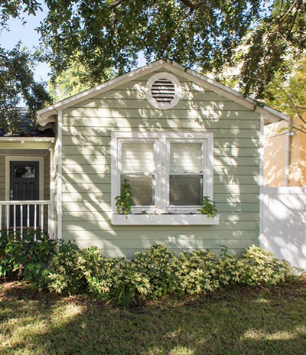




leading vacation rental online marketplace company
Expediting on-boarding of new properties by 70%
Turn Around Time (TAT)
improvement by 70%
71% of the listings completed within
2 days as compared to set target of
5 days
2x rise in activation rate
Increased speed and listing quality helped double the activation rate
Host initiates
Listing
BOT deployed on
Google Cloud
gathers publicly available information and runs AI
Final Review
Regular API Upload
Listing is Activated
40% reduction in TCO
Lowered maintenance and cost for infra, process, integration effort
Self-service automation
Object detection for property images with 88% accuracy
Speed for Value
Copyright © 2020 Infogain Corporation. All Rights Reserved.

Slide 4



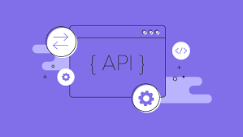

Automation for a leading vacation rental online marketplace company
Automating for a Global Digital Company – Challenge and Solution
Leading Global Digital Company that operates an online marketplace and hospitality service which is accessible via web and mobile apps
Poor Listing Experience
  Only 30% from marketing to listing
  Interviews, Shadowing Session, Contextual observations
  Design thinking workshops
  Customer journey mapping
  Business Process Improvement
  Automation using RPA and API
  Introduction of a service desk
  Hosting the solution on cloud
  Complete managed service offering
Long Turnaround Time
  More than a month to onboard a listing on platform
Manual Process
  Risk of errors from data entry, recon and data transfer
Unscalable Process
  Current volume of 30k+, expected to ramp to over 150k+
Client Problem Statement
Business Process Assessment
The Solution – Phase 1
Go–Live in 3 months after the process was streamlined

Slide 5


Automation for a leading vacation rental online marketplace company
Phase 1: Listing Process of hotel
Pre Automation
Average Time to Process : 15 to 30 Days
User Agent initiates discussion with Property Manager to generate a listing
User Agent Emails Property Listing Form to Property Owner
Property Owner
receives Listing Form in Excel
Property Owner
provide details in the Form and sends it back via email
User sends the Listing Form to Listing Team
User
Property is Live
Property Owner verifies and Publishes the Listing
Vendor Updates the details on Portal and transfer to Property Owner account
Listing team Validates the details with Property Owner
Vendor Fills the details, and sends to Listing team
Listing team sends the Form to Vendor to fill all other details
Post Automation
Average Time to Process : 8 hrs to 2 days
Property Manager raise request to create property listing
The request is created in JIRA against the Property listing
Ticket number is generated in JIRA
JIRA sends email to BOT
Bot Reads the email.
Bot extracts data from third party websites and updates the Listing Form
User
Property is Live
Property Owner verifies and Publishes the Listing
Bot uploads details using API to the PM account on "Enterprise"
Listing Team marks the listing for upload on Property Owner account
Listing team Validates the details with Property Owner
Bot Completes the Listing Form and sends it to Listing Team via JIRA ticket update

Slide 6
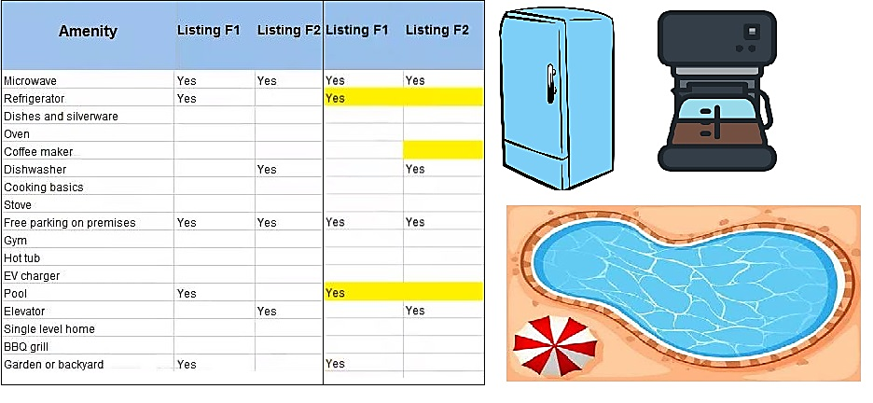

Automation for a leading vacation rental online marketplace company
Phase 2: A picture spells multiple amenities
Use Existing data
Get the property photos for amenities from the website
Analyze
Analyze and provide list of amenities for each photo listing
Suggest
The photos with amenities will be stored with the cognitive engine for analysis
Recommendations
For a new listing generate recommendations on the amenities based on photos.

Slide 7









Automation for a leading vacation rental online marketplace company
Phase 2: Automation using Cognitive technology
Training Dataset
Amenities Identified
AC
Bath Tub
Coffee-
maker
Property Images
Google - AutoML Vision
Desk
Kitchen
Pool
Train
Iterate
Evaluate
1000+ training images
5+ Iterations
88% accuracy
Refrigerator
TV
Training time:
1
2 hrs. to 6 hrs. per iteration
2
Total duration to build the Model:
8 weeks

Slide 8
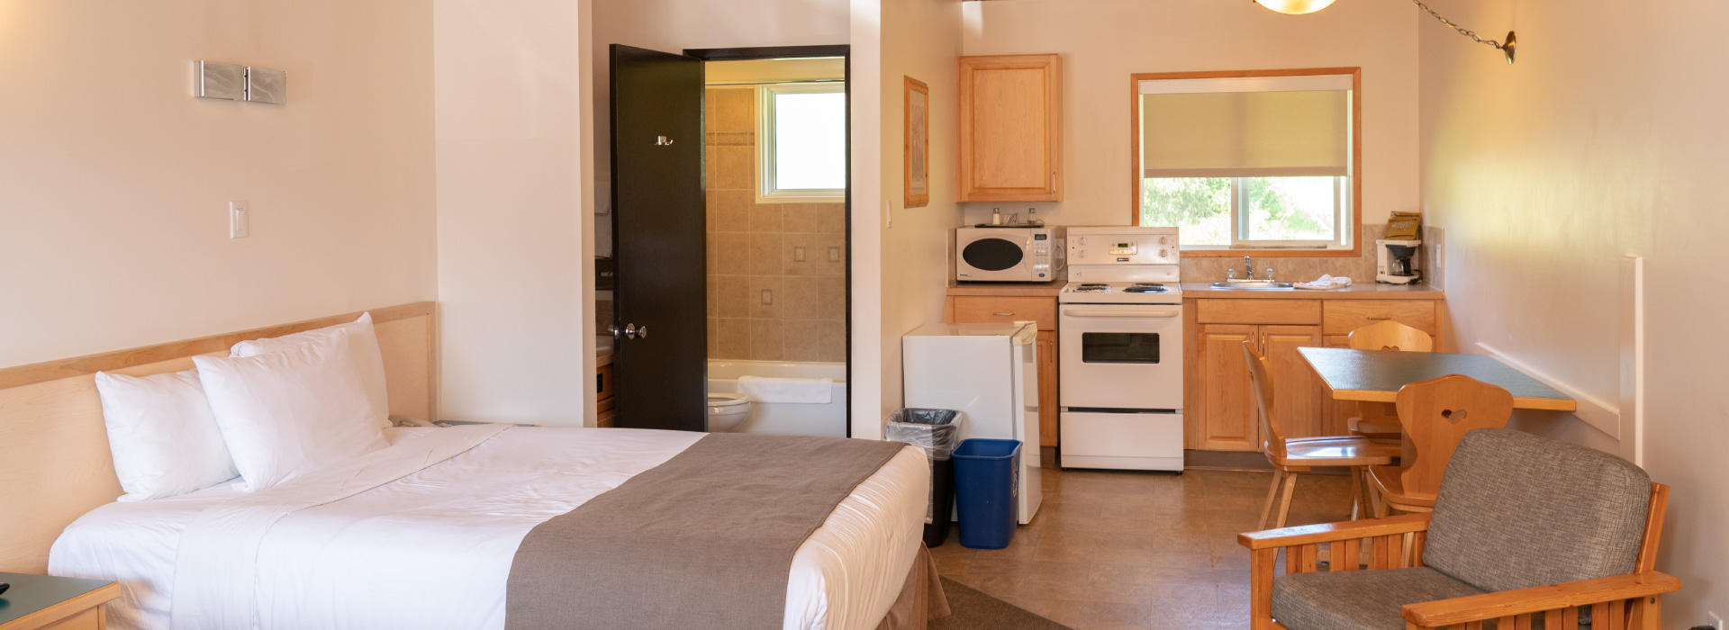
Automation for a leading vacation rental online marketplace company
Phase 2: Automation using Cognitive technology
1. AC
2. Bathtub
3. Coffeemaker
4. Desk
5. Kitchen
6. Pool
7. Refrigerator
8. TV

Slide 9





Automation for a leading vacation rental online marketplace company
The Outcome Delivered
2x Rise in Activation Rate
40% Reduction in TCO
TAT Improvement by 70%
Data Quality
Increased speed and listing quality helped double activation rate
Cost Optimization – infra, process, integration effort
Low Maintenance
71 % of the listings completed within 1.5 days as compared to set target of 5 days
Improved data quality and eliminated rework
First partner to move AA to cloud (GCP) – Showcased at Imagine London and New York 2019
First Implementation of Google AI integration with AA BOTs – Showcased at Google NXT 2019

Slide 10
Automation for a leading vacation rental online marketplace company
Case Study Video on YouTube
https://www.youtube.com/watch?v=0H0qryc7z9k
Infogain practice video: Hyperautomation

Slide 11

Automation for a leading vacation rental online marketplace company
Mapping the services provided in this case study to to our Services Catalog
Services
Service Offering
Sub Service Offering
Hyperautomation Consulting
Strategy & Assessment
Automation blueprint
CoE Strategy & Setup.
Automation
Architecture and Planning
Automation Maturity Assessment
Demand
Generation
Opportunity Workshops
Detailed Opportunity Assessment with Business Case
Opportunity Mgmt.
Process Identification and Improvement Design
Business Process Improvement
Business Process
Performance Assessment
Business Process
Improvement and rollout
Continuous Improvement
Robotic Process Automation
Intelligent Automation
Low Code App Platform (LCAP)
Automation of Service, Data, Process
Chatbots
`Decision Mgmt. System
Integration platforms
Hyperautomation engineering
Scripting Frameworks
IT Process / Tool based
IBPMS
Automation Hub
Factory Model
Pod Model
Managed Hyperautomation Services
Automation Ops
Manage Technology Partner and Licenses
Service
Management
Platform Ops
Bot Monitoring

Slide 12
Radhakrishnan R
rk@infogain.com

